Slide 1
Software Life Cycle Models

Slide 2
Content:
1. Types of testing methodologies.
2. Description of testing methodologies.
3. Pros and cons of testing methodologies.
4. Comparative summary table.

Slide 3
1. Types of Testing Methodologies:
Cascading model (the Waterfall model)
Iterative model (the “repetition” model)
Spiral модель
V- model

Slide 4
2. Description of Testing Methodologies:
The cascade model (the Waterfall model) is a model of the software development process in which the development process looks like a stream that goes through phases of requirements analysis, design, implementation, testing, integration and support. The transition from one phase to another occurs only after the complete and successful completion of the previous one.

Slide 5
Benefits:
Consecutive execution of project stages in a strict fixed order
Allows you to evaluate the quality of the product at each stage
Disadvantages:
Lack of feedback between stages
Does not meet the real conditions of software product development.

Slide 6
An iterative model (the “repetition” model) is the execution of work in parallel with the continuous analysis of the results obtained and the adjustment of the previous stages of work. The project with this approach in each phase of development passes through a repeating PDCA cycle: Planning - Implementation - Verification - Evaluation

Slide 7
+ early creation of working software;
+ flexibility - willingness to change requirements at any stage of development;
+ Each iteration is a small stage for which testing and risk analysis is easier to provide than for the entire product life cycle.
- each phase is independent, individual iterations are not superimposed;
- problems may arise with the implementation of the overall system architecture, since not all requirements are known to the beginning of design.

Slide 8
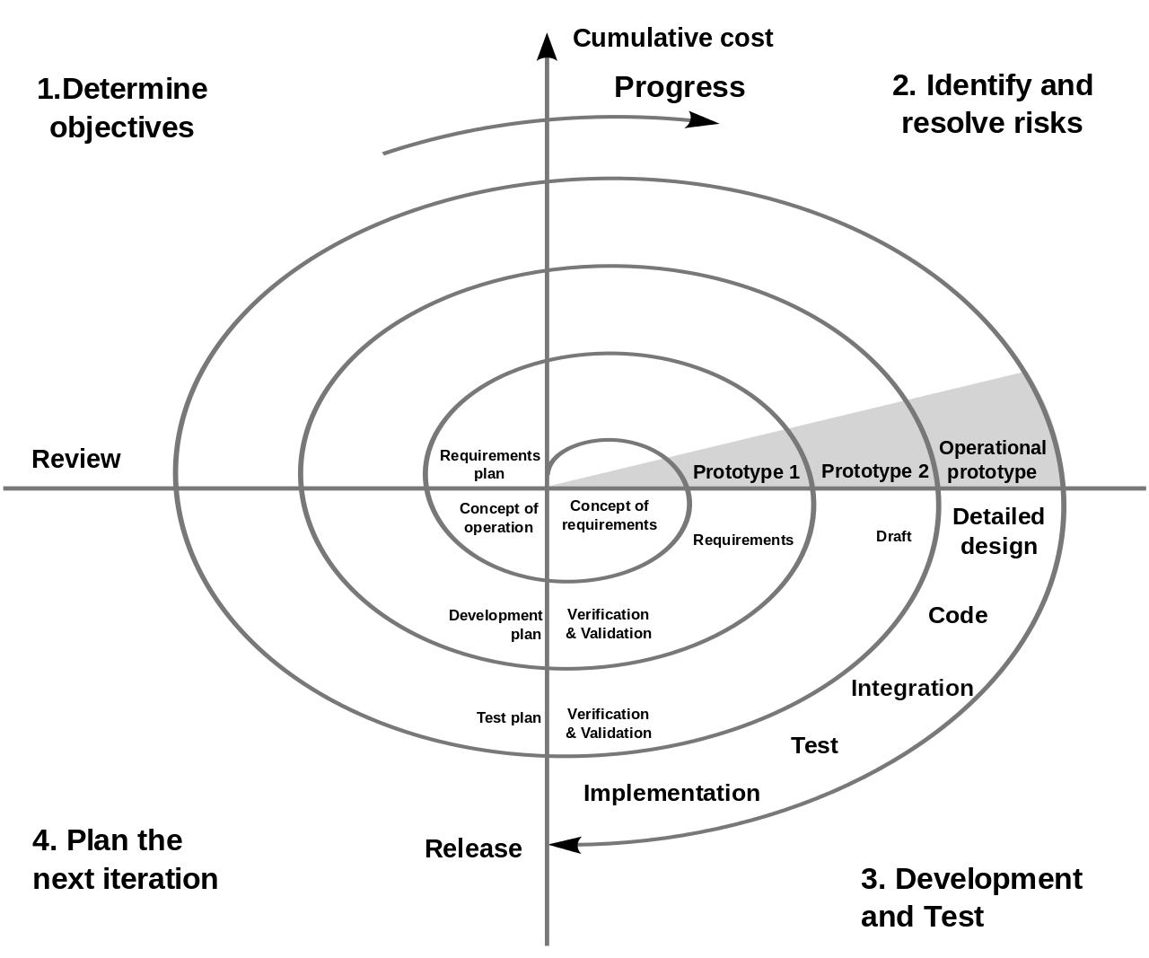
The spiral model is a software development process that combines both design and step-by-step prototyping in order to combine the advantages of an upstream and downstream concept.

Slide 9
+ improved risk analysis;
+ good documentation of the development process;
+ flexibility - the ability to make changes and add new functionality even at relatively late stages;
+ early creation of working prototypes.
- can be quite expensive to use;
- risk management requires the involvement of highly qualified specialists;
- the success of the process to a large extent depends on the stage of risk analysis;
- not suitable for small projects.

Slide 10
V-model - is a model for the development of information systems (IS), aimed at simplifying the understanding of the complexities associated with the development of systems. The main principle of the V-shaped model is that the detail of the project increases when moving from left to right, simultaneously with the passage of time, and neither one nor the other can turn back. Iterations in the project are performed horizontally, between the left and right sides of the letter V.

Slide 11
+ strict stageization;
+ test planning and verification of the system are carried out in the early stages;
+ improved, compared with the cascade model, time management;
+ intermediate testing.
- lack of flexibility of the model;
- the actual creation of the program occurs at the stage of writing code, that is, already in the middle of the development process;
- insufficient risk analysis;
- there is no work with parallel events and the possibility of dynamic changes.

Slide 12
Model | Benefits | Disadvantages | Testing
Cascading | Each stage has a verifiable result. At each point in time, the team performs one type of work. Works well for small tasks. | - Complete inability to adapt the project to changes in requirements | - From the middle of the project
Iterative | Fairly early prototyping Easy iteration management Project decomposition into controlled iterations | Lack of flexibility within iterations Difficulty in resolving problems missed in the early stages of the project | At certain points of iterations Repeated testing (after completion) of the previously verified
Spiral | - In-depth risk analysis Suitable for large projects Fairly early prototyping | High overhead Complexity application for small projects High dependence on the quality of risk analysis | At certain points of iterations Repeated testing (after completion) of the previously verified
V - shaped | Each stage has a clear verifiable result. Attention is paid to testing from the first stage. Works well for projects with stable requirements. | Lack of flexibility and adaptability No early prototyping | - On transitions between stages

